Slide 1

SLIDE 1
Team Name- BioHackers
2. Members Name and Phone Numbers
Gauri Ghule(leader) – 9518559475
Triyaksh Mathur – 9860910769
Nishant Chandolia - 9619659447
3. Domain name- Open Innovation (Image Processing)
4. Problem statement- Predicting the genetic composition of tumor using images for brain cancer treatment.

Slide 2
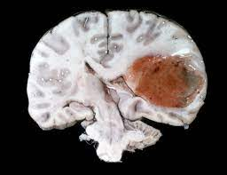
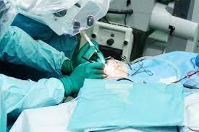
SLIDE 2
ABSTRACT
Glioblastoma, a malignant tumor in the brain is a life-threatening condition. It can occur at any age but tends to occur more often in older adults. It can cause worsening headaches, nausea, vomiting and seizures. It's both the most common form of brain cancer in adults and the one with the worst prognosis, with median survival being less than a year. The presence of a specific genetic sequence in the tumor known as MGMT promoter methylation has been shown to be a favorable prognostic factor and a strong predictor of responsiveness to chemotherapy.
Currently, genetic analysis of cancer requires surgery to extract a tissue sample. Then it can take several weeks to determine the genetic characterization of the tumor. Depending upon the results and type of initial therapy chosen, a subsequent surgery may be necessary. The development of an accurate method to predict the genetics of the cancer through imaging would potentially minimize the number of surgeries and refine the type of therapy required.

Slide 3

SLIDE 3
NOVELTY
A surgery not only have a physical effect but also a major psychological effect. It can cause changes in a personality and ability to think. Patients may experience challenges with their communication, concentration, memory and emotional abilities. Most brain tumor patients exhibit signs that are consistent with depression and agitation, especially post surgery. Patients may feel self worthlessness. Many lose interest in their usual activities, and they become socially isolated. The prescribed medicines post surgery can also have a massive impact on one’s life. We are developing a web-based application that will predict the genetics of the tumor, making it easier for the doctors to proceed with the treatment without the need of an invasive diagnosis (surgery). This application can assist doctors in decision making and plan the best course of treatment for the patient.

Slide 4

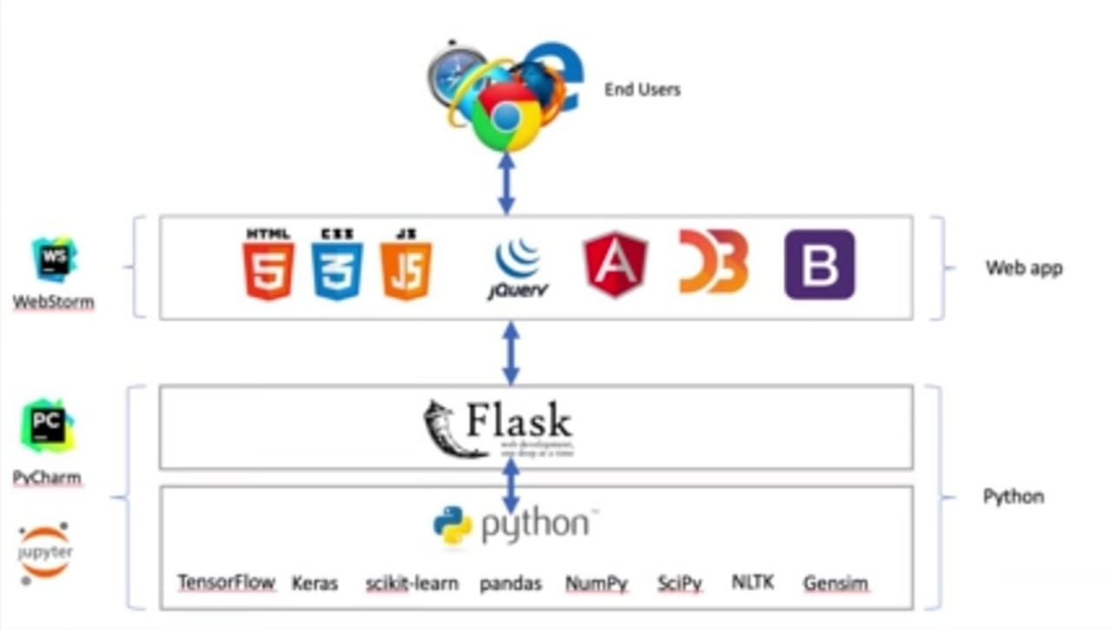
SLIDE 4
TECHNOLOGY
STACK
Deploying a Website Stack comprises of
FRONT END CLIENT SIDE-HTML – Hypertext Markup Language and CSS – Cascading Style Sheets
BACK-END SERVER SIDE-PROFRAMMING LANGUAGES-PYTHON for building CNN(Convolutional Neural Network) for image classification.(TensorFlow, Keras, NumPy)
DATABASE- Open-Source Brain Tumor MRI database on Kaggle

Slide 5
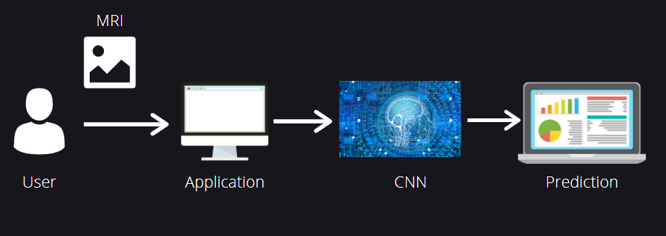
SLIDE 5
SOFTWARE IMPLEMENTATION
Embed a DL model in Web Application (created in Flask)Creating Deep learning model for Brain Tumor Image Classification. Developing web-app using Flask and integrate the model in the application.
FUTURE PROSPECT – Deploying the app on Cloud Service.

Slide 6

SLIDE 6
BUSINESS SCOPE
The global cancer diagnostics market size is projected to reach USD 26.6 billion by 2026 from USD 17.2 billion in 2021, at a CAGR of 11.5% during the forecast period. The primary users of our innovation are the healthcare workers- mainly Doctors. Deployment of the application and its access to the cloud service will ensure that the innovation can benefit the intended users globally. Continuous R and D will ensure that the innovation is ready to compete with the always evolving market.

